Slide 1
Entity Relationship Modeling
Key Concepts:
Business Rules
Data Models
Entities, Attributes, Relationships, Constraints
Entity Relationship Diagrams
Chen, Crow's Foot, UML, Relational Diagrams
Composite Attributes
Divide into simpler attributes
Derived Attributes
Consider whether to store in a column or compute when needed.

Slide 2
Business Rules
Business rules are descriptions of policies, procedures, or principles within a specific organization that relate to the organization's use of data.
Business rules describe the characteristics of the organization's data as viewed by the organization.
NOTE: The "organization" may not be a business.
Ideally, each business rule should be brief, precise, unambiguous, and accurate.
E.g.
A customer may generate many invoices.
An invoice is generated by only one customer.
A training session cannot be scheduled for fewer than 10 or more than 30 employees.

Slide 3
Purposes of Business Rules
Business rules:
Standardize the organization’s view of data.
Communicate between customers and database designers.
Allow database designers to understand the nature, role, and scope of data.
Allow database designers to understand the business processes that the data support.
Allow database designers to understand the relationships and constraints between the different types of data.

Slide 4
How to Get Business Rules?
Sources of business rules:
Interviews
Organization managers, policy makers, department managers, etc.
Try and verify what they say.
E.g. "Any mechanic can initiate a maintenance procedure".
Written documentation
Procedures
Standards
Operations manuals
Direct observations of end-users
May yield undocumented rules that "everyone knows".

Slide 5
Data Models
Data models represent real-world data structures.
Like all models, they abstract away (i.e. ignore) some details and complexities of the real-world.
People in different roles use and understand data in different ways and at different levels of abstraction.
Database designers
Programmers
End Users
Executives, Mid level management, Sales people, Customers, …..
A good data model should allow for different perspectives on the data and facilitate different uses (including unforeseen ones) of the data.

Slide 6
Data Model Building Blocks
Entity: anything about which data are to be collected and stored.
E.g. Employee, Customer, Event, ….
Usually an entity is represented by a TABLE, not a row.
Attribute: a characteristic of an entity.
E.g. name, address, date, …
Usually an entity is represented by a column.
Don’t make something an entity if it's just an attribute!
If it has no attributes of its own, it's NOT an entity.
(Unless it's a bridge entity – see later.)
Relationship: an association among entities (usually, but not always, between 2 entities).
Constraint: a restriction placed on the data.
E.g. The wage rate must be above $7.25/hr.
E.g. A class must have between 6 and 30 students.

Slide 7
Types of Relationships
There are 3 types of relationships between 2 entities:
One-to-one (1:1) relationship
E.g. If each store is managed by a single employee;
and
each store manager (who are employees) only manages one store;
then:
the relationship between EMPLOYEE and STORE is 1-1, even though some employees don't manage any stores.
One-to-many (1:M) relationship
E.g. A painter may paint many paintings, but each painting is painted by a single painter.
Many-to-many (M:N) relationship
E.g. A student may take many classes, and a class may be taken by many students.

Slide 8
Relationships in Both Directions
VERY IMPORTANT!
The type of a relationship reflects both directions.
Thus once the type of the relationship between A and B is specified, do NOT specify the type of the relationship between B and A!
Do NOT do this sort of thing:
Class to Student is a 1-Many relationship.
Student to Class is a 1-Many relationship.
The correct statement is:
Class - Student is a Many-Many relationship.

Slide 9
Data Model Components
To translate business rules into data model components:
Some nouns translate into entities.
Other nouns translate into attributes.
Verbs translate into relationships among entities.
Relationships are bidirectional.
Two questions to identify the relationship type:
How many instances of B are related to one instance of A?
How many instances of A are related to one instance of B?

Slide 10
Example
E.g. "A customer may generate many invoices."
Customer and Invoice are entities.
Generate is a relationship.
Consider the (implicit) other direction:
"An invoice is generated by one customer".
Thus the Generate relationship from Customer to Invoice is 1:M

Slide 11
Naming Conventions
The data model components need to be NAMED in a consistent and clear way.
Facilitates communication between database designers and customer.
Promotes self-documentation.
Names should make each object (entity, relationship, or attribute) unique and distinguishable from other objects.
It is good practice to include the name of the entity as a prefix to the name of an attribute; e.g. EMPLOYEE_NAME.
Names should be descriptive of objects in the environment and be familiar to users.
Names should always be SINGULAR, since each table or attribute denotes a single thing.
Names should be consistent.
Don't name the employee-name field EMP_NAME if the customer-name field was named Name_Of_Customer or CustName.

Slide 12
The Entity Relationship Model
The Entity Relationship Model (ERM) is a widely accepted standard for data modeling.
It is commonly used to model relational databases but can be used for other types of data models.
Introduced by Peter Chen in 1976.
An Entity Relationship Diagram (ERD) uses graphical representations to model database components.
Each entity is represented by a rectangle.
ENTITY NAME, a noun, is written in CAPITAL letters.
Entity instance (or entity occurrence) is a row in a table.
Entity set is a collection of like entities – all the rows in a table.
E.g. all the employees.
Relationships are drawn between entities.
The relationship name, a verb, is written in small letters.

Slide 13
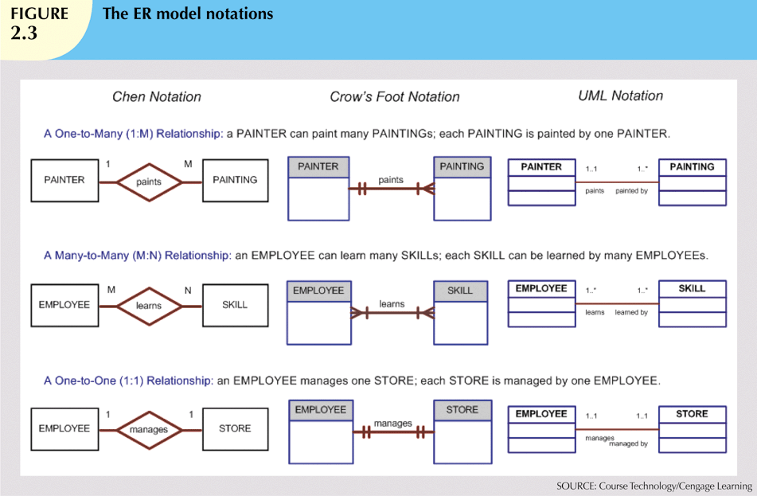
ERM Notations
Crow’s Foot notation is used as design standard in this class.

Slide 14
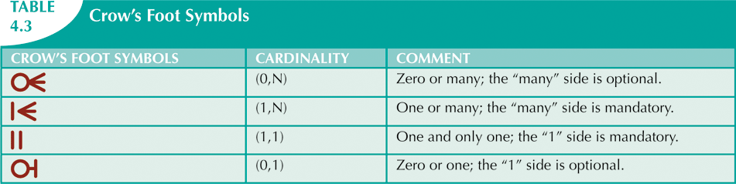
Crow’s Foot Symbols

Slide 15
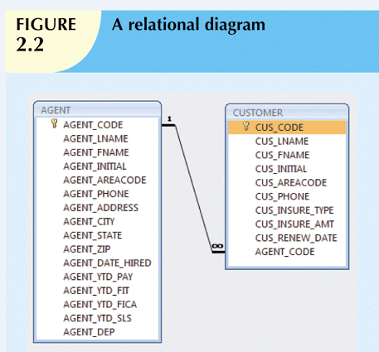
Relational Diagrams
Most DBMS use an alternative notation, a relational diagram.
E.g. in SQL Server, right-click on Database Diagrams, select New Database Diagram, select the tables that you want, and click Add.

Slide 16
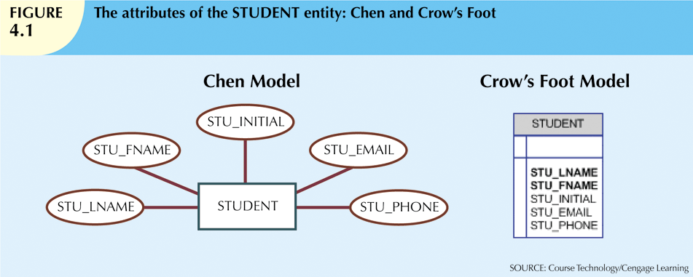
Attributes
Attributes are characteristics of entities.
In Crow’s Foot Model:
Attributes are written in an attribute box below the entity rectangle.
In Chen Model:
Attributes are represented by ovals connected to the entity rectangle with a line.
Each oval contains the name of the attribute it represents.

Slide 17
Terminology
Required attribute: must have a value.
Bolded in ERD.
Optional attribute: may be left empty.
Domain: set of possible values for an attribute.
Attributes may share a domain; e.g. STUDENT_ADDRESS, INSTRUCTOR_ADDRESS.
Identifiers: one or more attributes that uniquely identify each entity instance.
Underlined in the ERD.
Composite identifier: identifier composed of more than one attribute.
NOTE: An identifier does NOT depend on the actual data.
One of the identifiers will become the primary key.

Slide 18
Composite vs Atomic Attributes
Composite attribute: an attribute that can be subdivided.
E.g. Name, which can be broken into the First Name, Middle Name, Last Name.
Simple (or atomic) attribute: attribute that cannot be subdivided.
Example: age (?), SSN, marital status.
Composite attributes should usually be split into multiple simple attributes.
Makes querying easier.

Slide 19
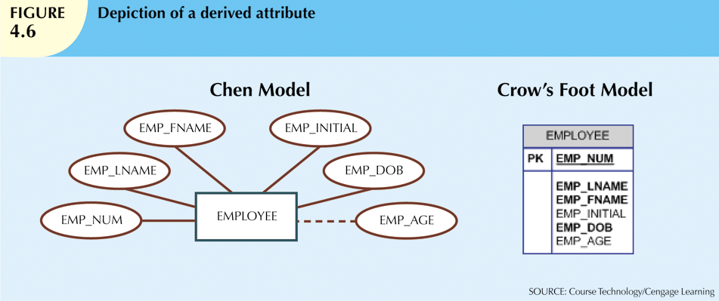
Derived Attributes
A derived attribute (or computed attribute) is an attribute whose value can be calculated from other attributes.
E.g. age can be calculated from date-of-birth and current time.
Indicated by dashed line in Chen model.
Not indicated in Crow's Foot model.

Slide 20
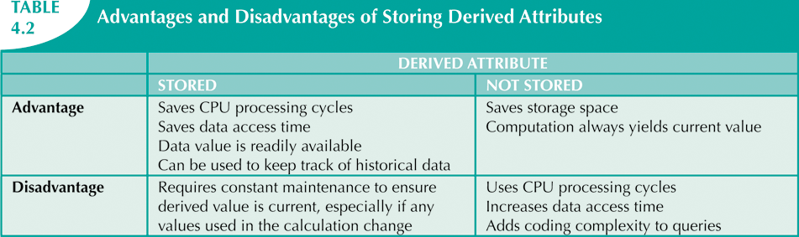
Derived Attributes

